Slide 1
Unsupervised Machine Learning: An Application in Seismic Data Analysis
Hugo Coussens
Project Supervisors: Lukas Mosser and Professor Olivier Dubrule

Slide 2
Project Motivations
Previous studies have highlighted potential use of unsupervised machine learning as an seismic amplitude vs offset (AVO) analysis tool: Mosser et al. (2019), Desai (2019).
A software package delivering the analysis could:
Greatly simplify full workflow
Enable quick and efficient utilisation of the analysis
Promote further interest for investigation and research into the area
Result:

Slide 3
Presentation Outline:
Unsupervised learning algorithms
Application to seismic data
Case study results
Overview of the SeismicReduction Python package
Outlook

Slide 4
Unsupervised Machine Learning
Learns patterns intrinsic to data
No data labels
Common uses:
Clustering
Feature extraction
Data Compression
Dimensionality Reduction
Notes:
-Explain how mnist is high dimensional
-Model can reduce dimension and preserve the important information (the actual number)
-The number is its feature for us the feature is not a number but physical properties from the seismic data.

Slide 5
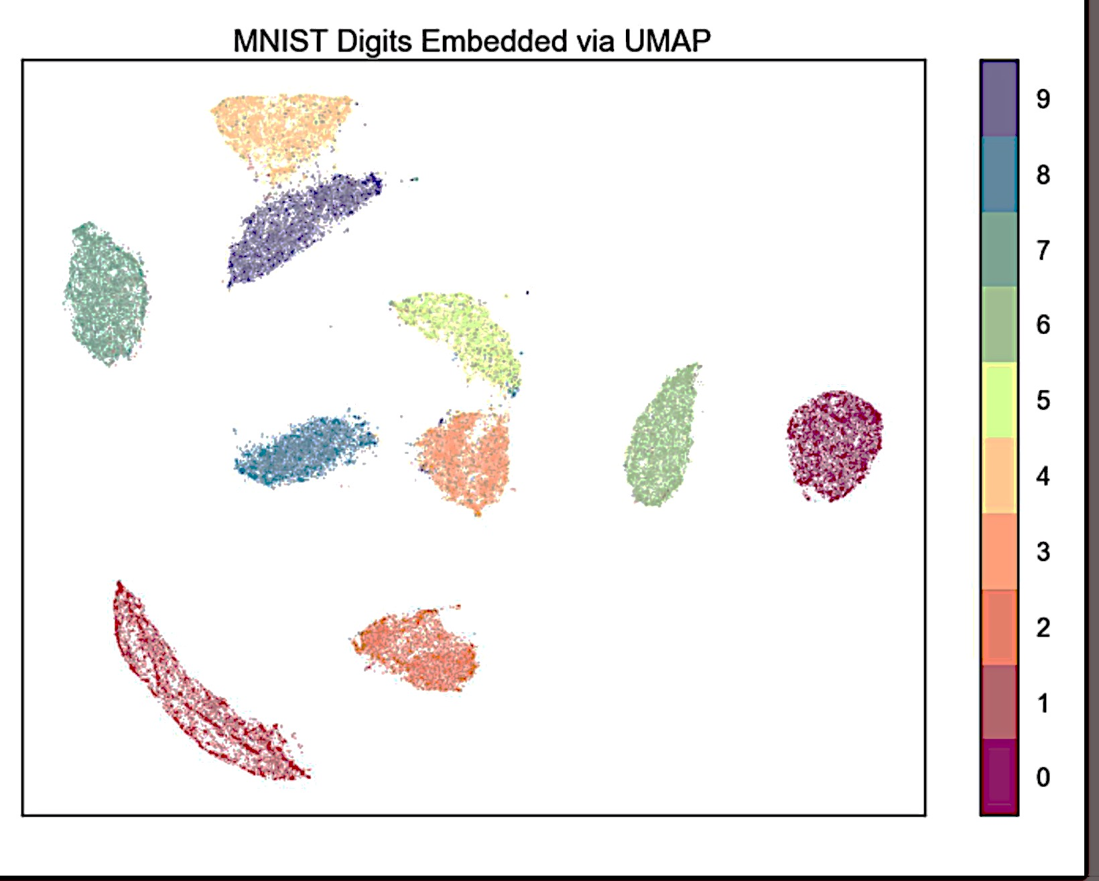
Dimensionality reduction example: MNIST
Dimension = 784
Dimension = 2

Slide 6
Models used
Linear:
Principal Component Analysis (PCA)
Non-Linear:
Uniform Manifold Approximation and Projection (UMAP)
Variational Auto-Encoder (VAE)

Slide 7
UMAP
Manifold projection
Preserves data distribution in from high to low dimension
Learn a mapping of the data from high to low dimension
Assumes data is uniformly distributed on locally connected Riemannian manifold

Slide 8
VAE
Optimisation of the Evidence Lower Bound (ELBO)
Reconstruction error
Kl-divergence from Gaussian prior
Latent space is continuous
β-VAE adds additional factor to KL-divergence
Disentanglement of features

Slide 9
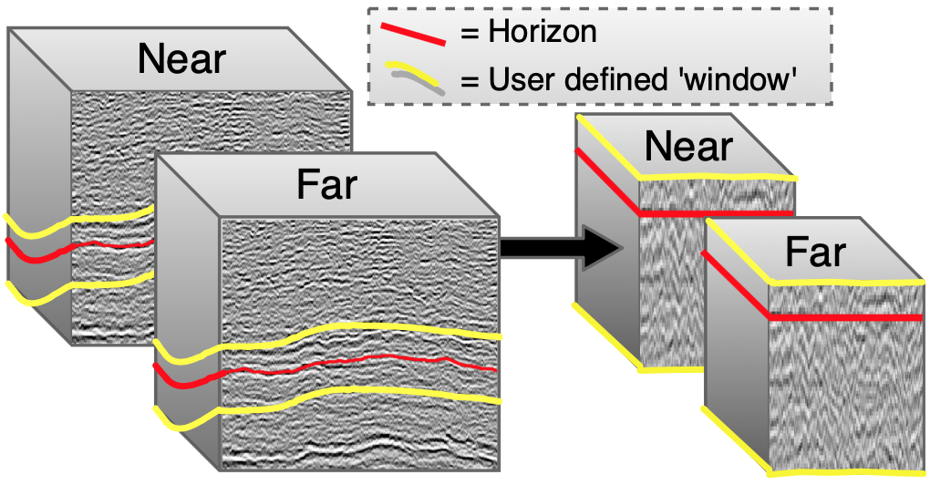
Engineering model inputs:
Data processing:
Horizon Flattening
Normalisation
Near/Far trace combination

Slide 10
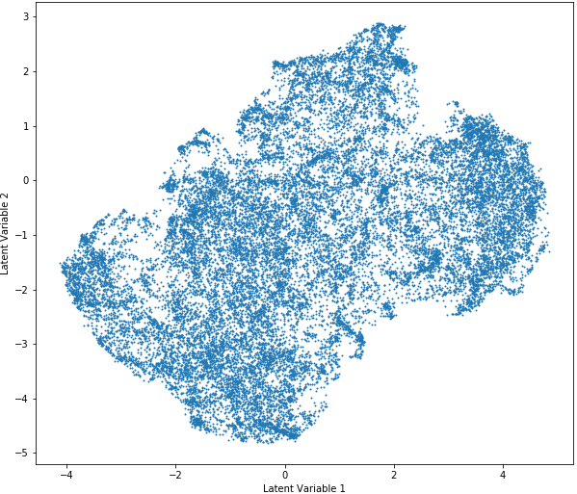
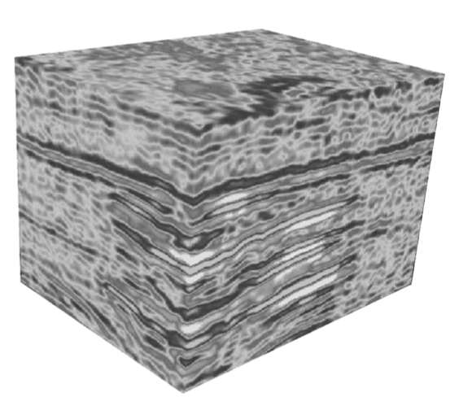
Dimensionality Reduction Models
Helpful?

Slide 11
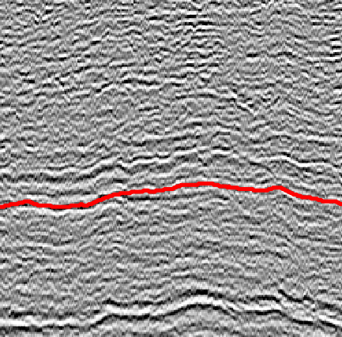
Dimensionality Reduction models
2. Horizon depth per trace
1. AVO attribute calculation

Slide 12
UMAP:
PCA:
Results:

Slide 13
Results:
VAE:
β-VAE:

Slide 14
Overview of software

Slide 15
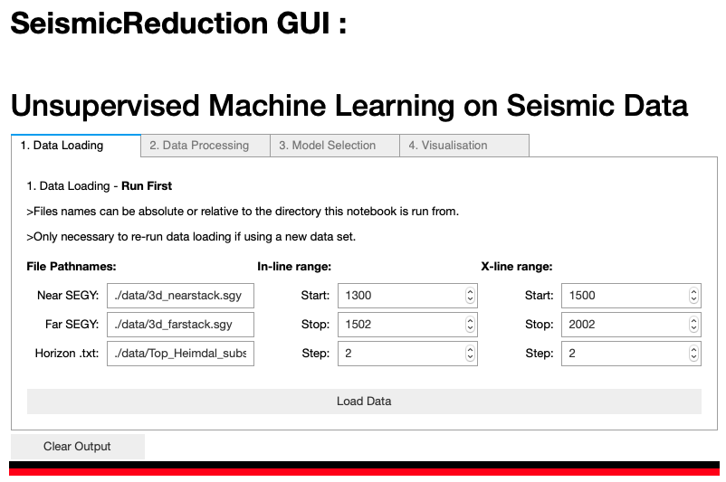

Slide 16
Software and GUI Benefits
Encapsulation of data pipeline
Exposure of important workflow parameters:
Data processing parameters
Model learning parameters

Slide 17
Summary
ℝ^{n} ⇒ ℝ² for visualisation of dataset
Models show the ability to learn meaningful features (physical attributes)
Quick analysis that shoes promise to be able to cluster data by AVO anomaly

Slide 18
References
Desai, S. (2019). Application of Deep Learning Techniques for Amplitude Variation with Offset Analysis. Imperial College MSci Project.
Mosser, L., Monte, A. A., Avseth, P., Draege, A., and Macgregor, L. (2019). Investigating the AVO Signature of a North Sea Oil-Field Using Pseudo-Wells and Unsupervised Deep Learning. In 81st EAGE Conference and Exhibition 2019 - AI/Digitalization for Interpretation - AVO Application.

